Slide 1
Qualities (values) over time
Modeling how values change over time
(Very Preliminary)
1/22/2021
See Also:
“Lets discuss the situation.docx”
“Values Quantities and Units.PPT”

Slide 2
Perspective
Qualities of entities, including people, are rarely static – they change over time. i.e. they are “temporal”
DBMS, Medical records and many ontologies only model a snapshot of an entity
Fully understanding a patients medical situation requires understanding change over time
This document explains the model for temporal qualities
Status: This is just a first cut using slides from the meeting on 1/22/2021

Slide 3
A patient has a series of vital signs over their lifetime
Based on situation semantics foundation
(paper in git)
A particular quality value exists at the intersection of the subject (state of), predicate and an occurrence in time
time
Encounter
Measurement
activity
Body Temperature at measurement
John’s Body Temperature
101.5
Body Temperature Time Series
A set of qualities
State of
Has vital sign [*]
John Snow : Person

Slide 4
The measured temperature
Encounter
(Clinical Activity)
Has care subject
Patient
Joe Smith
Unit of measure
Degrees Fahrenheit
(Temperature, value)
Start time: 1/20/2010 1:20pm EST
End time: 1/20/2010 5:20pm EST
State of
Has vital sign
Scaler value:104.2
Has quality value
Has temporal part
predicate
Has relevant
da
Determined by
Vital Sign
(quality, situation)
Measurement Activity
(Observation Activity)
Body site
Snomed: body temperature
Snomed: mouth
Performed by
Has finding
Individual
Nurse Jackie
Start time: 1/20/2010 4:25pm EST
End time: 1/20/2010 4:30pm EST
Occurs at : 1/20/2010 4:30pm EST

Slide 5
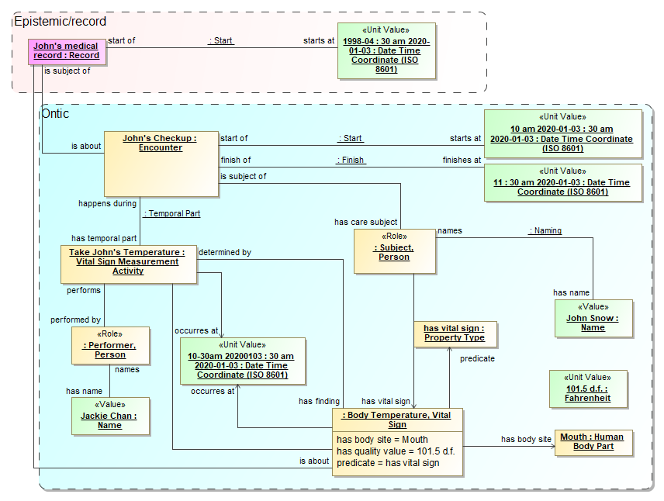
Thinking about
UML Instance Diagram
Needs work

Slide 6
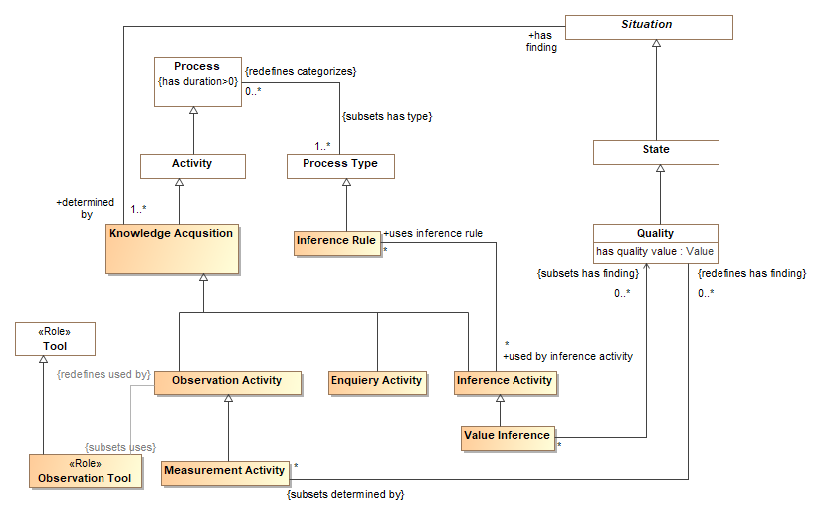
UML Model Fragment

Slide 7
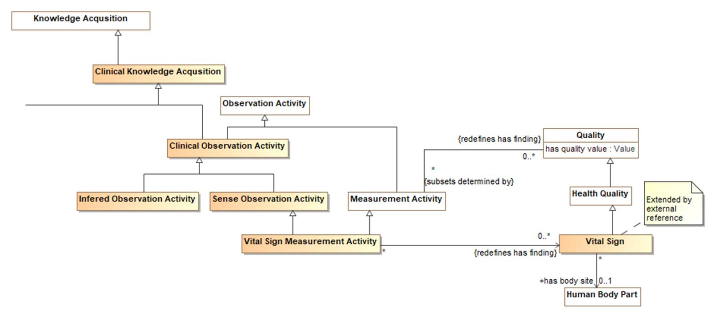
Qualities applied to vital signs

Slide 8
OLD VERSION

Slide 9
The measured temperature
Encounter
(Clinical Activity)
Has care subject
Patient
Joe Smith
Unit of measure
Degrees Fahrenheit
(Temperature, value)
Start time: 1/20/2010 1:20pm EST
End time: 1/20/2010 5:20pm EST
State of
Has vital sign
Scaler value:104.2
Has quality value
Measurement Result
(Observation, Belief)
Has temporal part
predicate
Results in
Occurs at: 1/20/2010 4:30pm EST
Is subject of
Has relevant
da
Results from
Vital Sign
(quality, situation)
Measurement Activity
(Observation Activity)
is about
Body site
Snomed: body temperature
Snomed: mouth
Performed by
Has finding
Individual
Nurse Jackie
Start time: 1/20/2010 4:25pm EST
End time: 1/20/2010 4:30pm EST
Occurs at : 1/20/2010 4:30pm EST

Slide 10
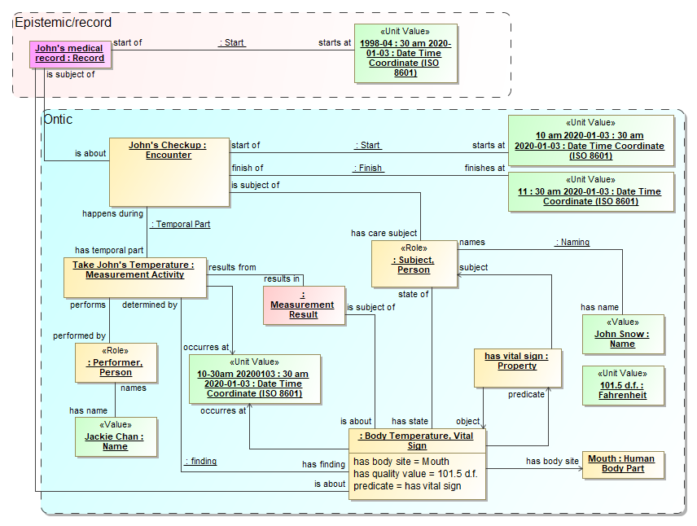
Thinking about
UML Instance Diagram
Needs work

Slide 11
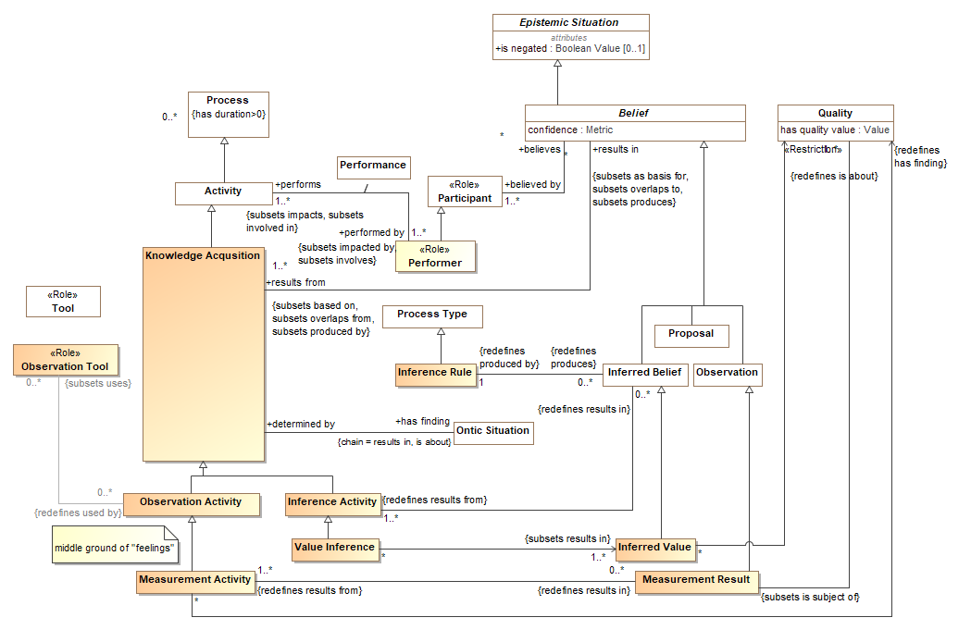
UML Model Fragment

Slide 12
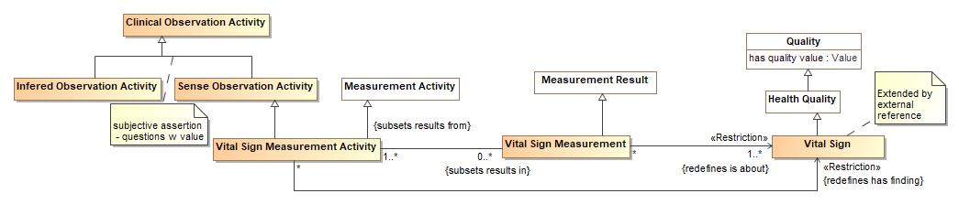
Qualities applied to vital signs

